Slide 1
هوش محاسباتی:
فرآیند های تکاملی
دانشكده مهندسي كامپيوتر
دانشگاه علم و صنعت ايران
ناصر مزيني
mozayani@iust.ac.ir
برنامه نویسی ژنتیک
Genetic Programming

Slide 2
GP overview
Developed by J. Koza in late 1980s
Typically applied to:
  machine learning tasks (prediction, classification…)
Attributed features:
  competes with neural nets and alike
  needs huge populations (thousands)
  slow
Special:
  non-linear chromosomes: trees, graphs
  mutation possible but not necessary (disputed!)

Slide 3
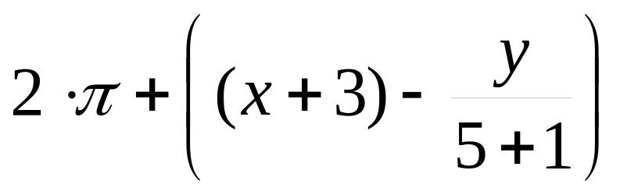
Tree based representation
Trees are a universal form, e.g. consider
Arithmetic formula
Logical formula
Program
(x ∧ true) → (( x ∨ y ) ∨ (z ↔ (x ∧ y)))
i =1;
while (i < 20)
{
i = i +1
}

Slide 4
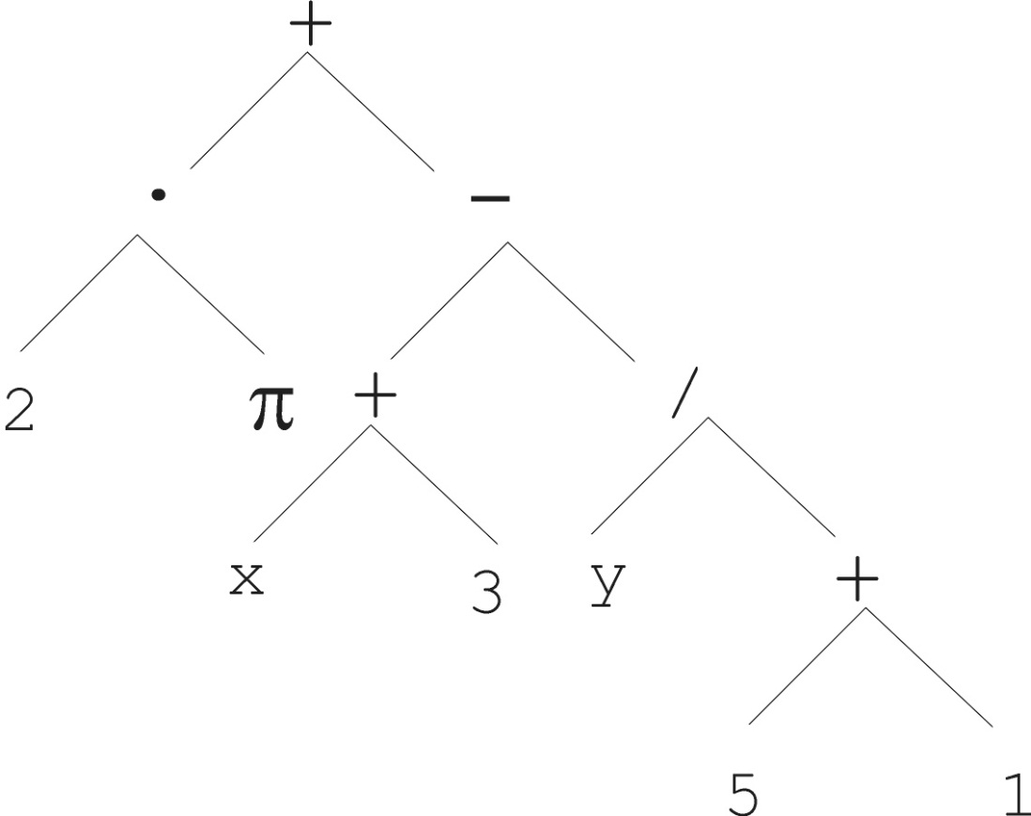
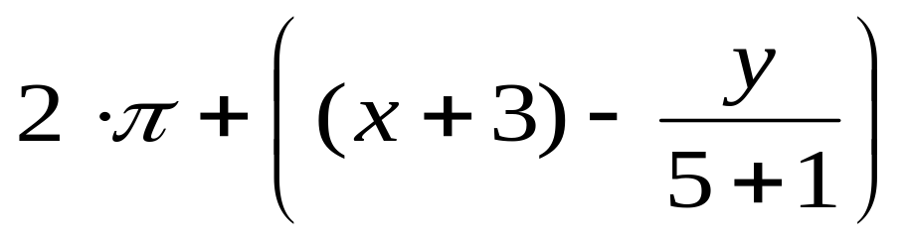
Tree based representation

Slide 5
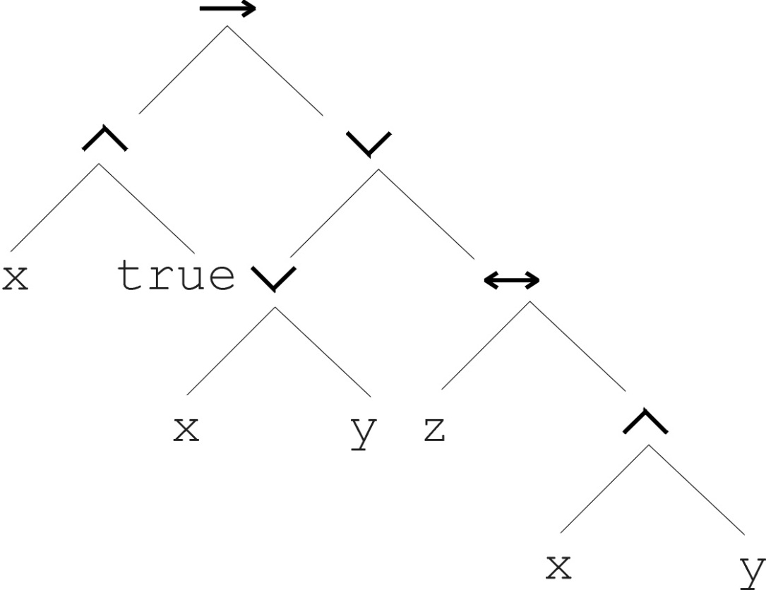
Tree based representation
(x ∧ true) → (( x ∨ y ) ∨ (z ↔ (x ∧ y)))

Slide 6
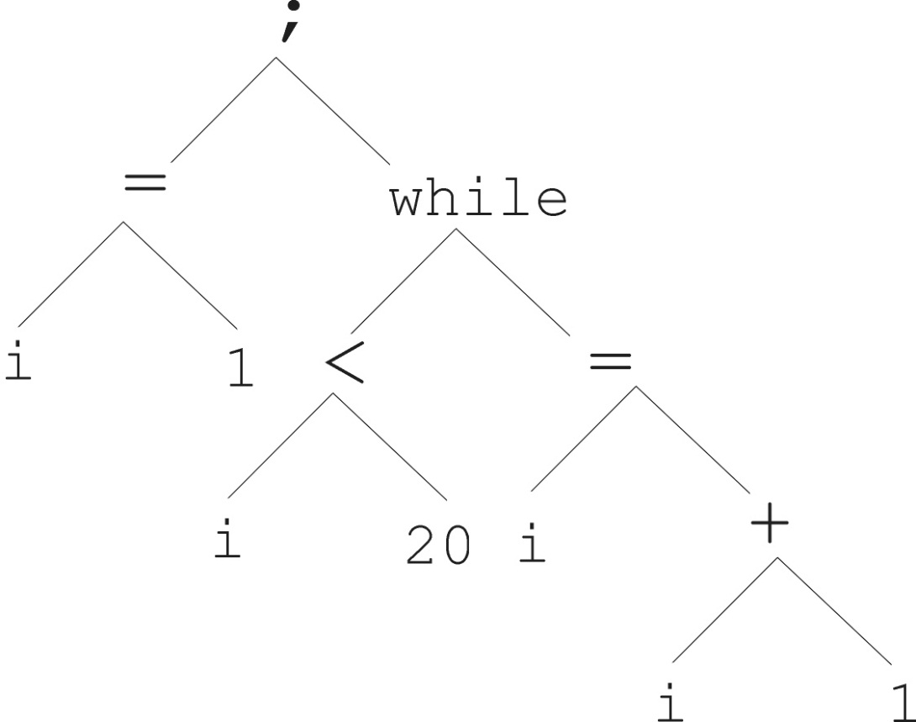
Tree based representation
i =1;
while (i < 20)
{
i = i +1
}

Slide 7
Tree based representation
In GA, ES, EP chromosomes are linear structures (bit strings, integer string, real-valued vectors, permutations)
Tree shaped chromosomes are non-linear structures
In GA, ES, EP the size of the chromosomes is fixed
Trees in GP may vary in depth and width

Slide 8
Tree based representation
Symbolic expressions can be defined by
  Terminal set T
  Function set F (with the arities of function symbols)
Adopting the following general recursive definition:
  every t ∈ T is a correct expression
  f(e₁, …, e_{n}) is a correct expression if f ∈ F, arity(f)=n and e₁, …, e_{n} are correct expressions
  There are no other forms of correct expressions
In general, expressions in GP are not typed (closure property: any f ∈ F can take any g ∈ F as argument) i.e. each function must successfully operate on all functions and terminals (any value of any data type)

Slide 9
Offspring creation scheme
Compare
GA scheme using crossover AND mutation sequentially (be it probabilistically)
GP scheme using crossover OR mutation (chosen probabilistically)

Slide 10
GP Process
Initialize population of computer programs
Determine fitness of each program
Reproduce according to fitness values and reproduction probability
Perform crossover of subexpressions
5. Go to step 2 unless termination conditions are met

Slide 11
Initialization
Initialize with randomly-generated programs using defined functions and terminals (build rooted tree)
No restrictions apply except maximum depth (which is significant!)
Population size varies, but 500 is common with Koza et al.

Slide 12
Initialization
Start with “root” function with number of branches = arity
Maximum initial depth of trees D_{max} is set
Full method (each branch has depth = D_{max}):
  nodes at depth d < D_{max} randomly chosen from function set F
  nodes at depth d = D_{max} randomly chosen from terminal set T
Grow method (each branch has depth ≤ D_{max}):
  nodes at depth d < D_{max} randomly chosen from F ∪ T
  nodes at depth d = D_{max} randomly chosen from T
Common GP initialisation: ramped half-and-half, where grow & full method each deliver half of initial population
+

Slide 13
Ramped Half-and-Half Approach
* Evenly distribute depth parameter from 2 to max. depth. So if max. depth is 11, 10 percent of population will have each depth (2, 3, ..., 11)
* Within each depth, 1/2 of the programs are built using grow approach, 1/2 using full approach

Slide 14
GP Fitness
Fitness must be calculated over a number of cases for each program. Average value often taken to be fitness. (Use perhaps 100 cases).
Same cases usually used throughout the run.
Four ways to calculate fitness defined by Koza:
- Raw fitness
- Standardized fitness
- Adjusted fitness
- Normalized fitness

Slide 15
GP Reproduction
Parent selection typically fitness proportionate
Often carried out in “parallel”
Sum of probabilities for reproduction and crossover = 100
- 10 % for reproduction typical
- 90 % for crossover typical
Both done after fitnesses are calculated
If reproduction selected, roulette wheel selection used

Slide 16
Selection
Over-selection in very large populations
  rank population by fitness and divide it into two groups:
  group 1: best x% of population, group 2 other (100-x)%
  80% of selection operations chooses from group 1, 20% from group 2
  for pop. size = 1000, 2000, 4000, 8000 x = 32%, 16%, 8%, 4%
  motivation: to increase efficiency, %’s come from rule of thumb
Survivor selection:
  Typical: generational scheme (thus none)
  Recently steady-state is becoming popular for its elitism

Slide 17
Crossover
Most common recombination: exchange two randomly chosen subtrees among the parents
Recombination has two parameters:
  Probability p_{c} to choose recombination vs. mutation
  Probability to chose an internal point within each parent as crossover point
The size of offspring can exceed that of the parents

Slide 18
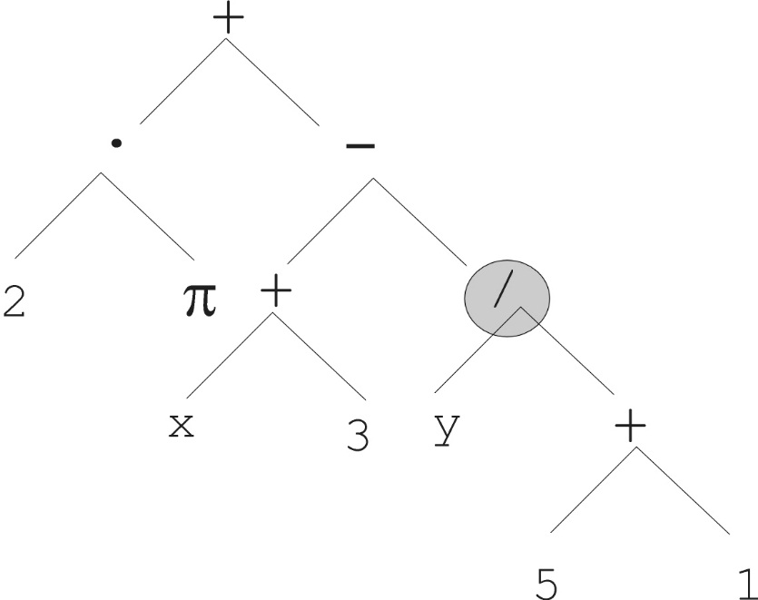
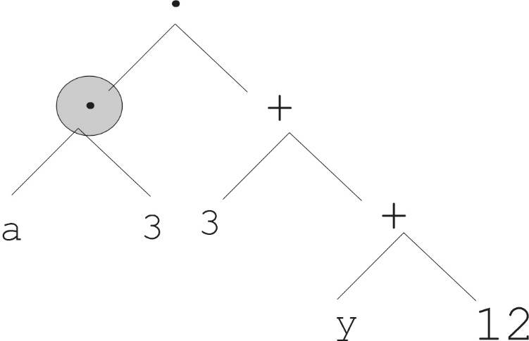
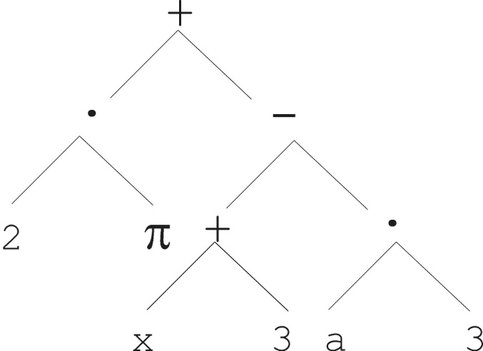
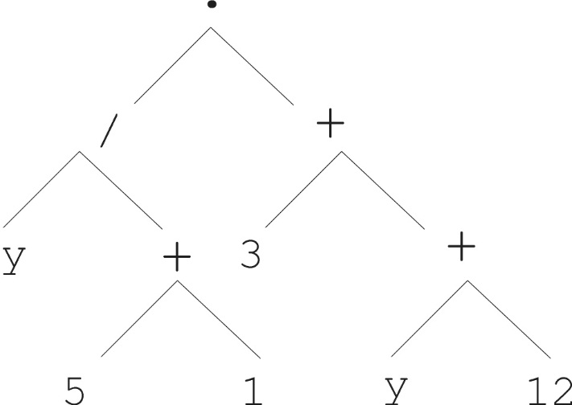
Parent 1
Parent 2
Child 1
Child 2

Slide 19
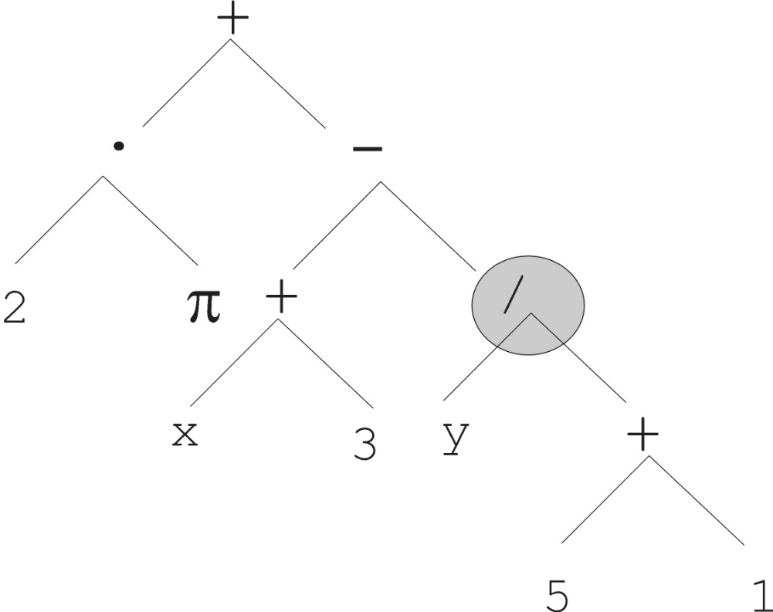
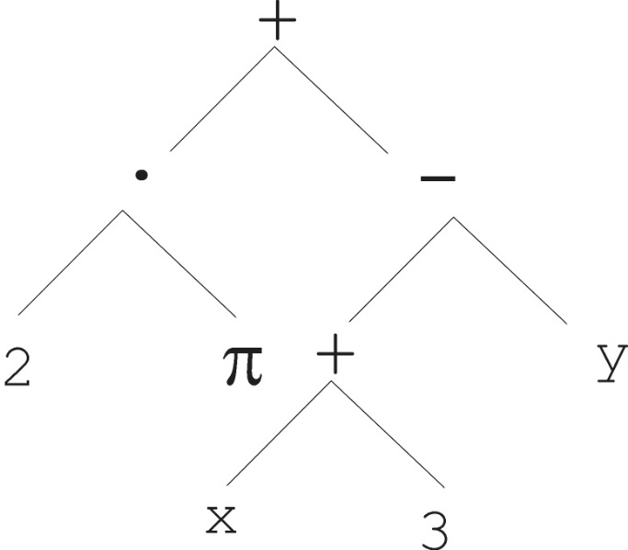
Mutation
Most common mutation: replace randomly chosen subtree by randomly generated tree

Slide 20
Mutation cont’d
Mutation has two parameters:
  Probability p_{m} to choose mutation vs. recombination
  Probability to choose an internal point as the root of the subtree to be replaced
Remarkably p_{m} is advised to be 0 (Koza’92) or very small, like 0.05 (Banzhaf et al. ’98)
The size of the child can exceed the size of the parent

Slide 21
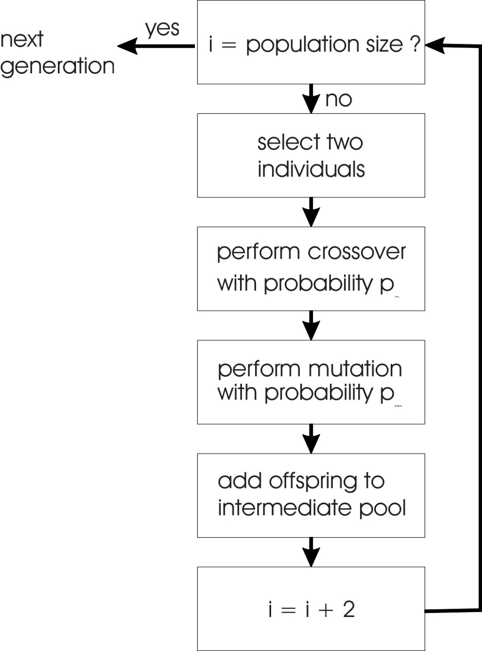
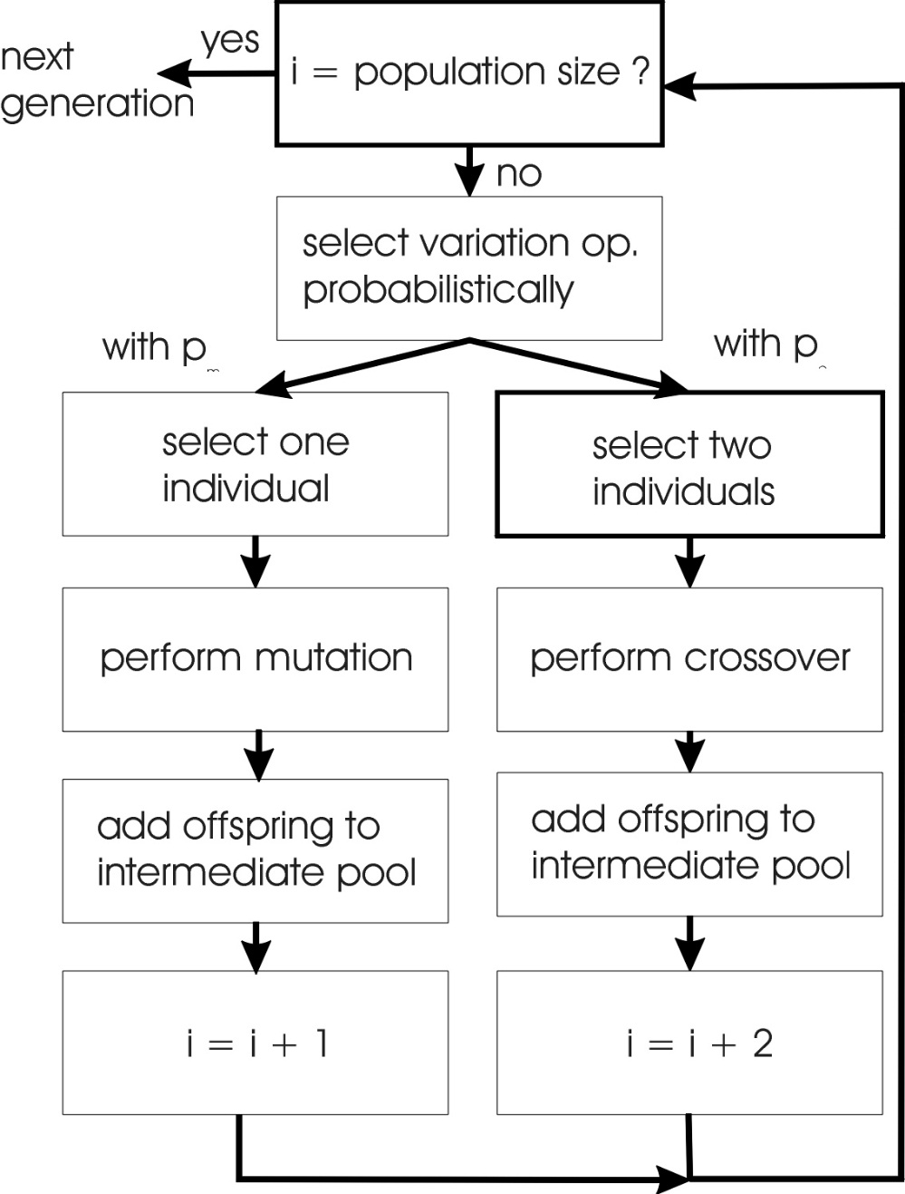
GP flowchart
GA flowchart

Slide 22
Bloat
Bloat = “survival of the fattest”, i.e., the tree sizes in the population are increasing over time
Ongoing research and debate about the reasons
Needs countermeasures, e.g.
  Prohibiting variation operators that would deliver “too big” children
  Parsimony pressure: penalty for being oversized

Slide 23
Fitness Measures and
Control Parameters
Variety of possible fitness measures
* Inversely proportional to error
* Game score
Control parameters
* Population size
* Max. no. of generations
* Reproduction probability
* Crossover probability
* Max. depth allowed (initial and final)

Slide 24
Problems involving “physical” environments
Trees for data fitting vs. trees (programs) that are “really” executable
Execution can change the environment → the calculation of fitness
Example: robot controller
Fitness calculations mostly by simulation, ranging from expensive to extremely expensive (in time)
But evolved controllers are often to very good

Slide 25
Termination of GP
Usually set by maximum number of generations specified
Best program created thus far usually selected as winner

Slide 26
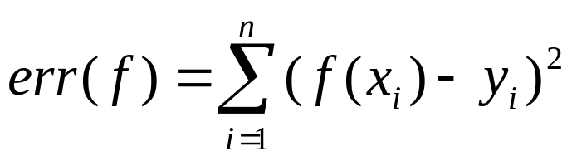
Example application: symbolic regression
Given some points in R², (x₁, y₁), … , (x_{n}, y_{n})
Find function f(x) s.t. ∀i = 1, …, n : f(x_{i}) = y_{i}
Possible GP solution:
  Representation by F = {+, -, /, sin, cos}, T = R ∪ {x}
  Fitness is the error
  All operators standard
  pop.size = 1000, ramped half-half initialisation
  Termination: n “hits” or 50000 fitness evaluations reached (where “hit” is if | f(x_{i}) – y_{i} | < 0.0001)

